Slide 1
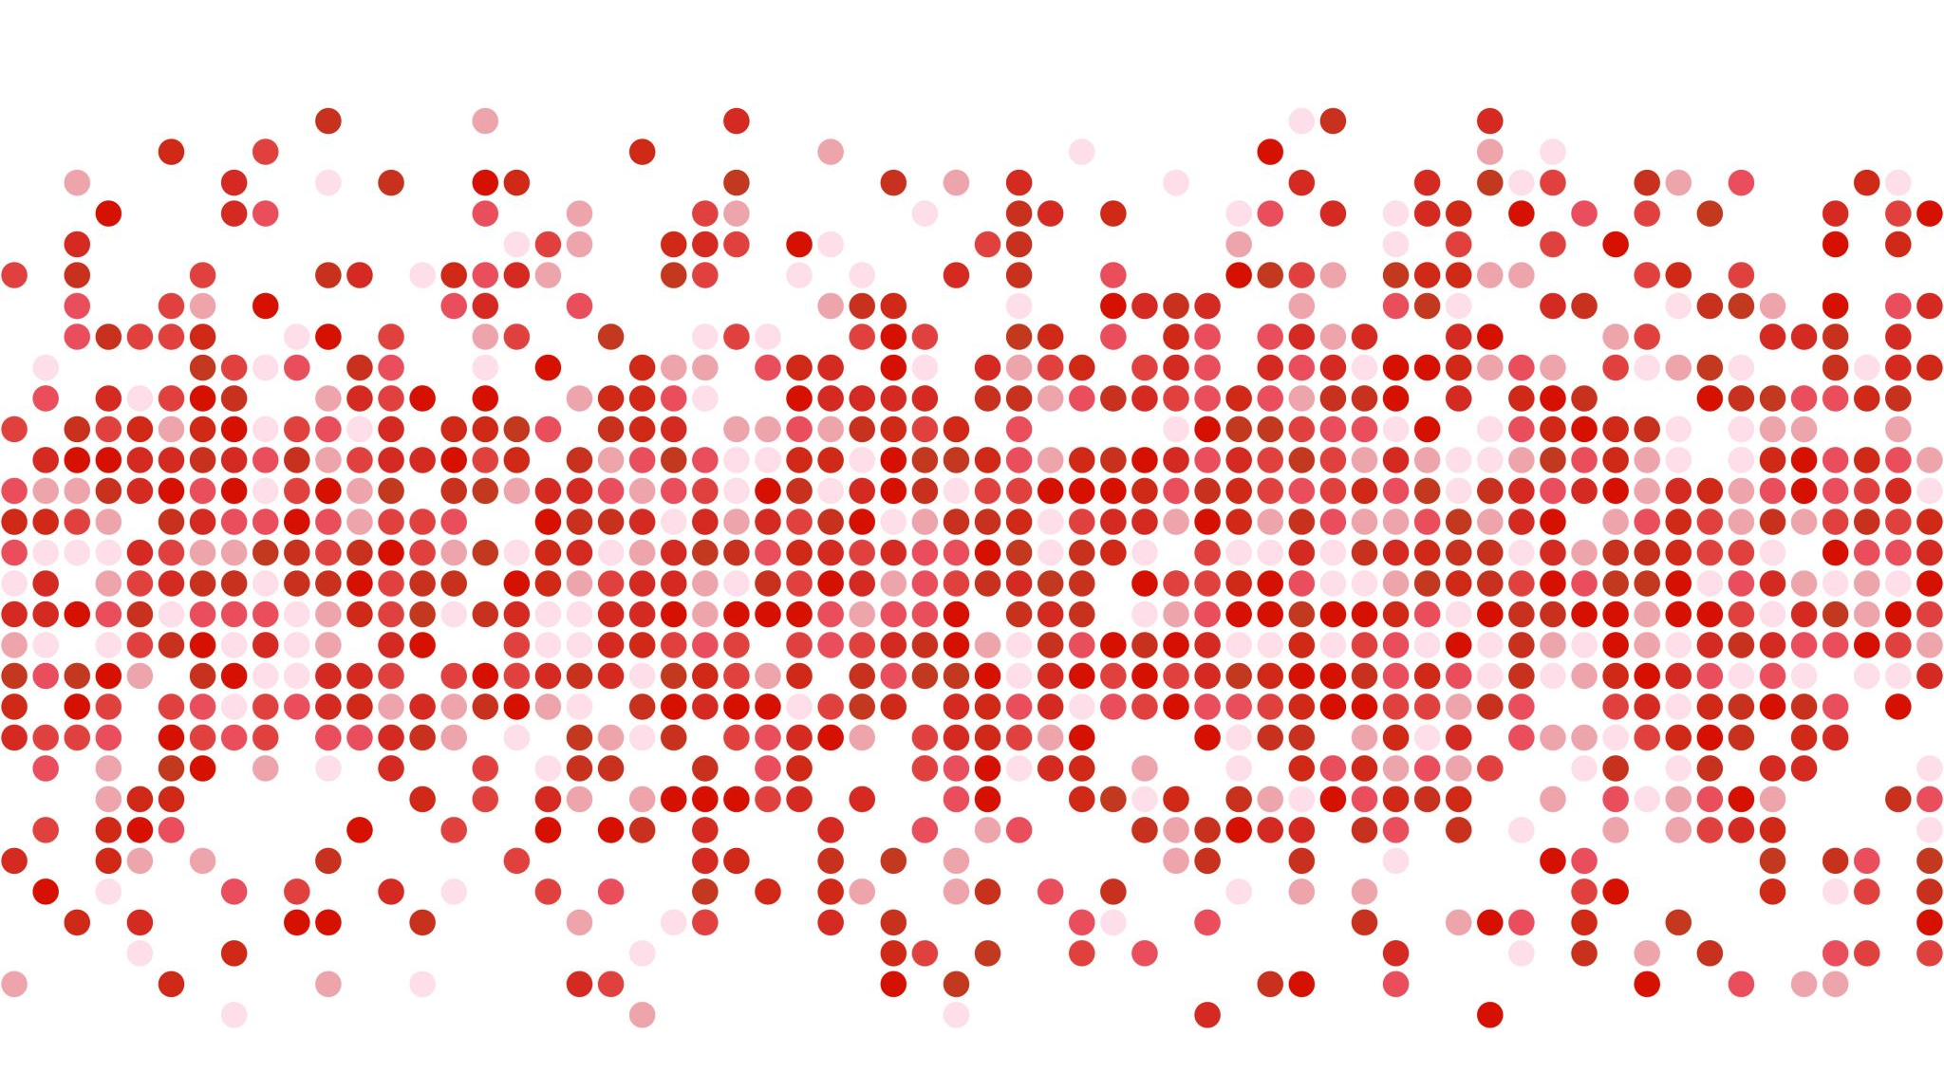
PA 446 Midterm
Ethan Jantz

Slide 2
Part A – Data Wrangling
Total Contract Value by month and state
data %>%
group_by(year(start_date), month(start_date), state_name) %>%
summarize(sum(total_contract_value)) %>%
rename(
year = `year(start_date)`,
month = `month(start_date)`,
state = `state_name`,
total_contract_value = `sum(total_contract_value)`
)

Slide 3
Part A – Data Wrangling
Second contract for relevant employers
data %>%
group_by(employer_id) %>%
slice(2) %>%
select(employer_id, contract_id, job_slots, click_marketplace_value)

Slide 4
Part B – Metric Design
In this section I’m assuming that all of the metrics must be able to be found within or derived from the given data.
My metrics:
Number of applications delivered as a simple metric
`click_marketplace_value` - `total_contract_value`, which we'll call `delivered_value`
The ratio of `click_marketplace_value` for the contract to the median for the same location
The percentage of `apply_start_clicks` that led to actual applications

Slide 5
Part B – Metric Design
Some of these metrics were derived using the variables we were asked to explore the performance of. This complicates trying to measure performance for each metric, but here are some plots that address the question.

Slide 6
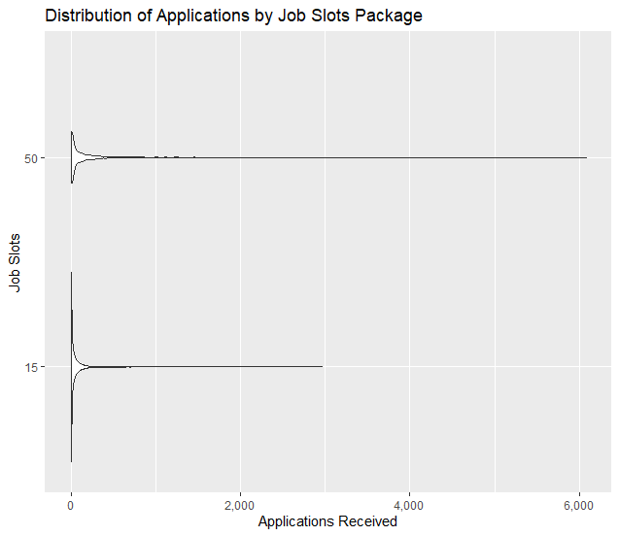
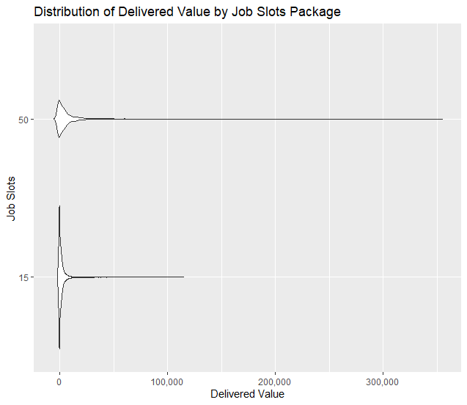
The larger job slots packages saw more applications per contract.
44% of contracts saw a delivered value of 0 or less, though larger job slots packages saw more positive delivered value

Slide 7
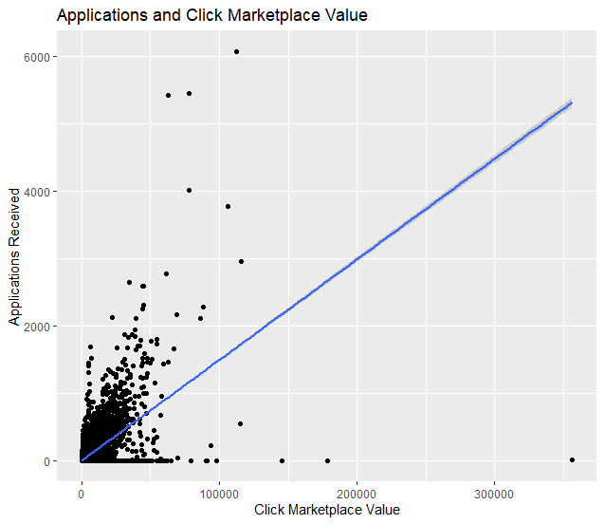
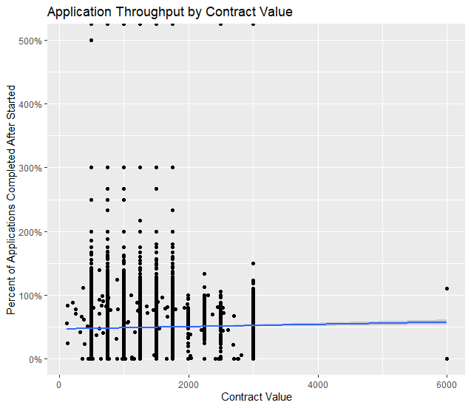
The data on applications versus apply start clicks is faulty but based on what was available approximately 48% of application starts resulted in a completed application. The size of the contract value had a small correlation with application completions.
The remaining metric, the click_marketplace_value ratio to the local median, didn’t seem to have any useful relationship to performance of the chosen variables.

Slide 8
Part C – Retention Modeling and Analysis
To best analyze retention, I crated a logistic regression model that included the following factors:
total_contract_value
click_marketplace_value
job_listings
job_slots
applications
apply_start_clicks

Slide 9
Part C – Retention Modeling and Analysis
I assumed that we're not worried about location and are instead focused on larger trends, so I won't be including location in this analysis. This assumption comes from the fact that the final part of the question is asking about how to alter the Ad Platform algorithm, and doesn’t discuss location outside of Part A.
I chose logistic regression because the goal is to understand which factors are related to an employer's likelihood to renew, which is a binary variable. This is a question that logistic regression is better suited for than OLS regression.

Slide 10
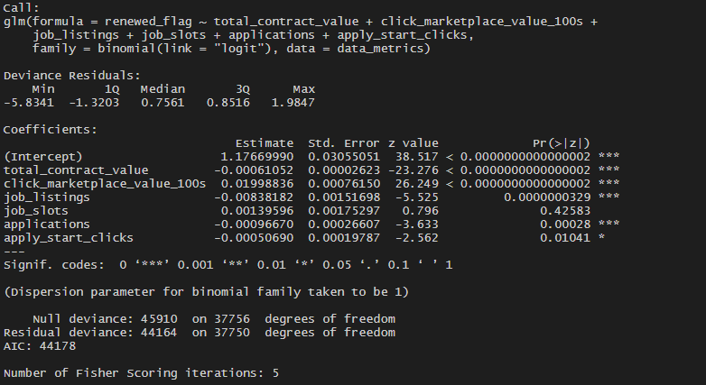
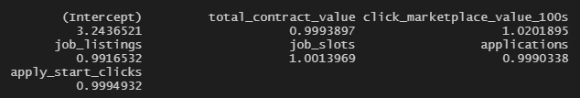
Part C – Retention Modeling and Analysis
All of these factors (except for job slots) are significantly related to retention.
Every 100 dollar increase in click marketplace value increases the odds of a renewal by 2%. This is shown in the exponentiated results of the model below.

Slide 11
Part C – Retention Modeling and Analysis
Based on this analysis, the biggest factor in improving retention is the click marketplace value. This value is the dollar value of the number of apply start clicks over the life of the contract.
Essentially, retention is more likely when an employer has received many apply start clicks where apply start clicks are scarcer. Originally the model included the delivered value metric instead of the click marketplace value, and the results were the same.
Because the number of apply start clicks is tied to demand and platform usage from prospective employees, and because the value of an apply start click is based on demand, modifying the bidding and search algorithms based on the findings of this analysis would be inappropriate.

